Slide 1
Data Analyst Assignment
Konstantinos Christogeorgos kostischristogeorgos@gmail.com

Slide 2
Agenda
Executive Summary
Problem - Business Impact
Model Approach
Performance - Validation
Business Recommendations - ROI

Slide 3
Executive Summary
This project develops an AI-based product matching system that automatically interprets unstructured customer descriptions and maps them to the most likely products in our inventory.
The system replaces manual matching, which currently requires 2–3 hours of staff time per day and often leads to fulfillment delays and lost sales.
The new proposed algorithm extracts product attributes, performs semantic similarity search and ranks the most relevant items with confidence scores.
Early tests show strong Top-1 (93.33%) and Top-3 (96.56%) accuracy, indicating high reliability. This solution significantly reduces manual workload, increases matching consistency, and improves the customer experience.

Slide 4
Problem - Business Impact
Problem:
Sales teams requests arrive through multiple channels (email, chat, phone, marketplace) and are often incomplete, misspelled, or ambiguous. Staff must manually interpret each request and identify matching items, which leads to:
  2–3 hours of daily manual work
  High chance of mismatches and order delays
Business Impact:
Our current process creates several business challenges:
  Lost sales opportunities when suitable alternative products exist but aren’t identified
  Inventory miscommunication and stockout-related confusion
  No structured or scalable way to analyze the most requested products

Slide 5
Model Approach
The solution uses AI to understand the meaning of a sales team’s description, extract key details and match them to the most relevant product in the catalog, while also giving the 3 most possible alternative options.
The process works in four steps:
Attribute Extraction: The system identifies color, size, brand, material, category, season and other attributes even with misspellings.
Hard Filtering: Products are filtered by strict attributes such as category, subcategory, season and year to narrow the search.
Semantic Matching: AI compares the meaning of the description with every product’s attributes from our catalogue, ranking the closest matches using cosine similarity.
Re-Ranking and Scoring: Products receive additional boosts for matching attributes (color, brand, material), producing a final confidence score and selecting the top match plus three strong alternatives.
This approach ensures both accuracy and transparency.

Slide 6
Performance - Results
Performance was evaluated using a labeled test set of 30 synthetic customer descriptions.
Key metrics used to validate the algorithm included:
Top-1 Accuracy: How often the best predicted SKU matches the true product.
Top-3 Accuracy: Whether the correct product appears among the top three results.
Precision & Recall: Reliability and completeness of the predictions.
Confidence Distribution: How confident the system is across all queries.
Results:
Top-1 Accuracy: 93.33%
Top-3 Accuracy: 96.56%
Precision & Recall: 87.5%
These results show that the model consistently identifies the correct product and provides highly reliable alternatives, making it suitable for real-world deployment.

Slide 7
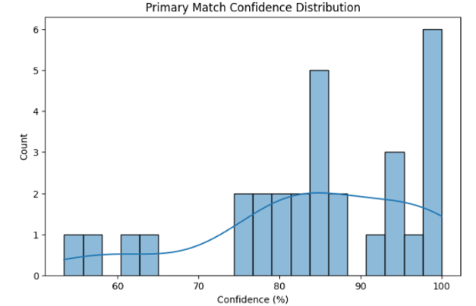
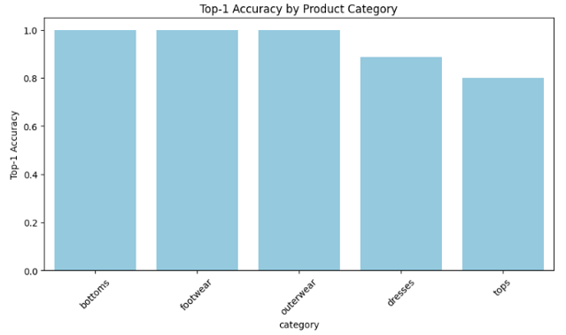
Visualizations
Confidence Distribution – The algorithm maintains an average confidence of around 85%, with even lower-confidence predictions still proving highly accurate.
Primary Match per Category – The algorithm matches 100% of bottoms, footwear and outwear while matching over 80% on dresses and tops in the test.

Slide 8
Business Recommendations - ROI
Operational Recommendations:
Confidence Threshold
Auto-approve matches ≥60% confidence; lower scores flagged for manual review.
Alert System
Trigger alerts for spikes in low-confidence predictions or repeated misses in specific categories.
Catalog Improvements
Address missing values and consider adding new features as description patterns evolve.
Scalability
Test model under real-time conditions for speed and robustness.
Use GPU servers and scheduled retraining for long-term efficiency.
ROI:
70–90% reduction in manual matching time → frees 2–3 hours of staff workload daily.
Fewer fulfillment errors → higher customer satisfaction and lower return rates.
Improved product discovery → captures missed sales where alternatives exist.
Better inventory insights → identifies most-requested items and stockout risks.
Fast deployment → model runs on existing product data and scales easily with catalog growth.

Slide 9
Thank you
Konstantinos Christogeorgos

